Slide 1
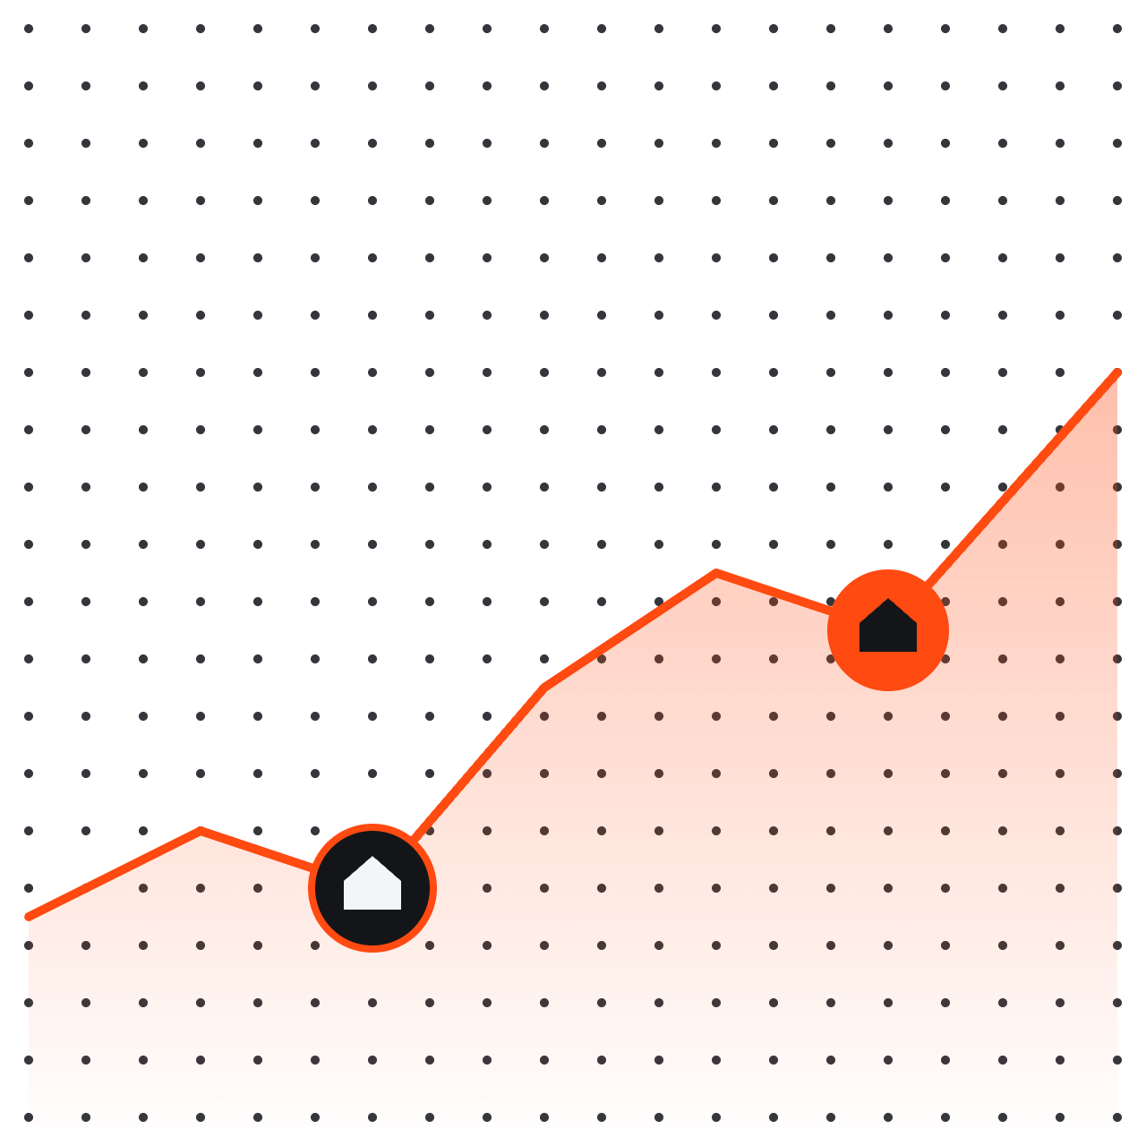
EDA Project
NEUE FISCHE · AI PROJECT MANAGEMENT
Exploratory Data Analysis · Real estate
TEAM MEMBERS
PRESENTATION DATE
Trupti, Serena
07.11.2026
Notes:
⏱ 0:20 — Speaker: [name]. Introduce the team and frame the role: we are real estate managers advising our client William Rodriguez on buying two homes.

Slide 2
Today’s agenda
OVERVIEW
The client
01
Who William is and what he needs
How we worked
02
From raw data to testable questions
What we found
03
Three hypotheses, and what each means for William
Two homes for William · EDA
02 / 18
Notes:
⏱ 0:20 — Speaker: [name]. ▶ Read the title aloud, then name the three parts — don’t read the text. Timing guide: client 1:00, how we worked 1:20, findings 5:40.

Slide 3
Our client &
modus operandi
01
PART 01
Who William is and how we worked
Notes:
⏱ 0:05 — Transition: “First, let’s meet our client and see how we approached his request.”

Slide 4




Two homes, two opposite priorities
01 — THE CLIENT
The brief
2 people, buying two homes
Country house
Buy at the best timing · non-renovated
William Rodriguez
Household of 2
City house
Fast purchase · central location
Two homes for William · EDA
04 / 18
Notes:
⏱ 1:00 — Speaker: [name]. ▶ Read the title aloud, then speak to the visual — don’t read the text.Introduce William as a person, not a dataset: two people, two homes, two very different priorities. Country house = patience (wait for the right season, accept a renovation project). City house = speed and location. Replace the avatar with a persona photo if you have one.

Slide 5
Clean + explore took 65% of our time
02 — OUR APPROACH
01
02
03
04
05
Brief
Clean
Explore
Test
Advise
Turn William’s needs into testable questions
Missing values, duplicates, data types
New features: $/sqft, distance to centre, season
Three hypotheses on filtered segments
Two concrete buying strategies
WHERE OUR TIME WENT
Data first, hypotheses second
10%
30%
35%
15%
10%
Brief
Clean
Explore
Test
Advise
Two homes for William · EDA
05 / 18
Notes:
⏱ 1:20 — Speaker: [name]. ▶ Read the title aloud, then speak to the visual — don’t read the text.Five steps from brief to advice. The bar shows where the effort really went: most of our time was spent cleaning and exploring the data before any hypothesis could be tested. Mention the key cleaning decisions and the features you engineered (price per sqft, distance to city centre, sale season). Adjust the percentages to your real time split.

Slide 6
Three questions we asked the data
03 — HYPOTHESES
H1
COUNTRY · TIMING
H2
CITY · LOCATION
H3
COUNTRY · CONDITION
THE QUESTION
THE QUESTION
THE QUESTION
When should William buy a non-renovated country house?
Where are compact city homes easiest to find?
Does skipping the renovation save money?
OUR HYPOTHESIS
OUR HYPOTHESIS
OUR HYPOTHESIS
Non-renovated country houses (400–2,000 sqft) have a lower median price per sqft in Oct–Feb than in Mar–Sep.
1–2 bedroom houses are more concentrated within 10 miles of the city centre than in outer areas, and cost more per sqft.
Unrenovated country houses sell at a 15–20% lower price per sqft than renovated homes in the same areas.
Two homes for William · EDA
06 / 18
Notes:
⏱ 0:40 — Speaker: [name]. ▶ Read the title aloud, then speak to the visual — don’t read the text.Each question comes straight from William’s brief; each hypothesis is our testable answer. H1 = best timing (country), H2 = central and fast (city), H3 = non-renovated (country). Keep this overview quick; the detail comes next.

Slide 7





Every clue checked before the verdict
03 — DATA CLEANING · THE INVESTIGATION
Survey the scene
Missing values
Found: 6,754 gaps in waterfront, view, yr_renovated, sqft_basement
We explored the dataset to understand how it was built.
Action: sqft_basement calculated (living − above); the rest filled with 0
Wrong formats
date: string → datetime
zipcode: int → string
id: int → text
Odd ones out
Found: 1 sale, a 33-bedroom house
It revealed some problems
Action: removed after a bedroom count check
Two homes for William · EDA
07 / 18
Notes:
⏱ 1:00 — Speaker: [name]. ▶ Read the title aloud, then tell it like an investigation — don’t read the text. Start on the left: before testing anything we explored the dataset to understand how it was built. That revealed three problems (follow the arrow): missing values, values stored in the wrong format, and sales that could not be real. For each, say what we found and what we did. Close with: only then were we ready to deliver a verdict on each hypothesis.

Slide 8
Hypothesis 1
H1
PART 02
Country house · Best timing
Notes:
⏱ 0:05 — Transition: “Our first question is about the country house: when is the best time to buy?”

Slide 9
When should William buy a non-renovated country house?
H1 · COUNTRY HOUSE · TIMING — THE TEST
Non-renovated country houses (400–2,000 sqft) have a lower median price per sqft in Oct–Feb than in Mar–Sep.
OUR HYPOTHESIS
01
02
03
04
Variables we used
A new variable: country house
Thresholds set by the data
Suitable for two people
yr_renovated, sqft_living, sqft_lot, lat, long, date, price
Defined by distance from downtown Seattle and lot size
Percentiles, not gut feeling: ≥ 16 mi (75th) and lot ≥ 20,000 sqft (90th)
Kept only homes that fit a couple: 400–2,000 sqft · 1–2 bedrooms
Two homes for William · EDA
09 / 18
Notes:
⏱ 0:40 — Speaker: [name]. ▶ Read the question aloud, then the hypothesis. Walk through the four steps: the variables we used (date gives us the sale month and season); the new variable “country house”, which did not exist in the data, built from distance to downtown Seattle and lot size; the thresholds — how far is far and how big is big — set from the data with percentiles rather than by gut feeling (at least 16 miles from downtown ≈ 75th percentile; lot of at least 20,000 sqft ≈ 90th percentile; 1,081 houses); and finally, because William is a household of two, we kept only country houses that suit a couple (400–2,000 sqft, 1–2 bedrooms), never renovated: 75 houses. On that group we compared median price per sqft between Oct–Feb and Mar–Sep (Mann-Whitney U test, α = 0.05).

Slide 10
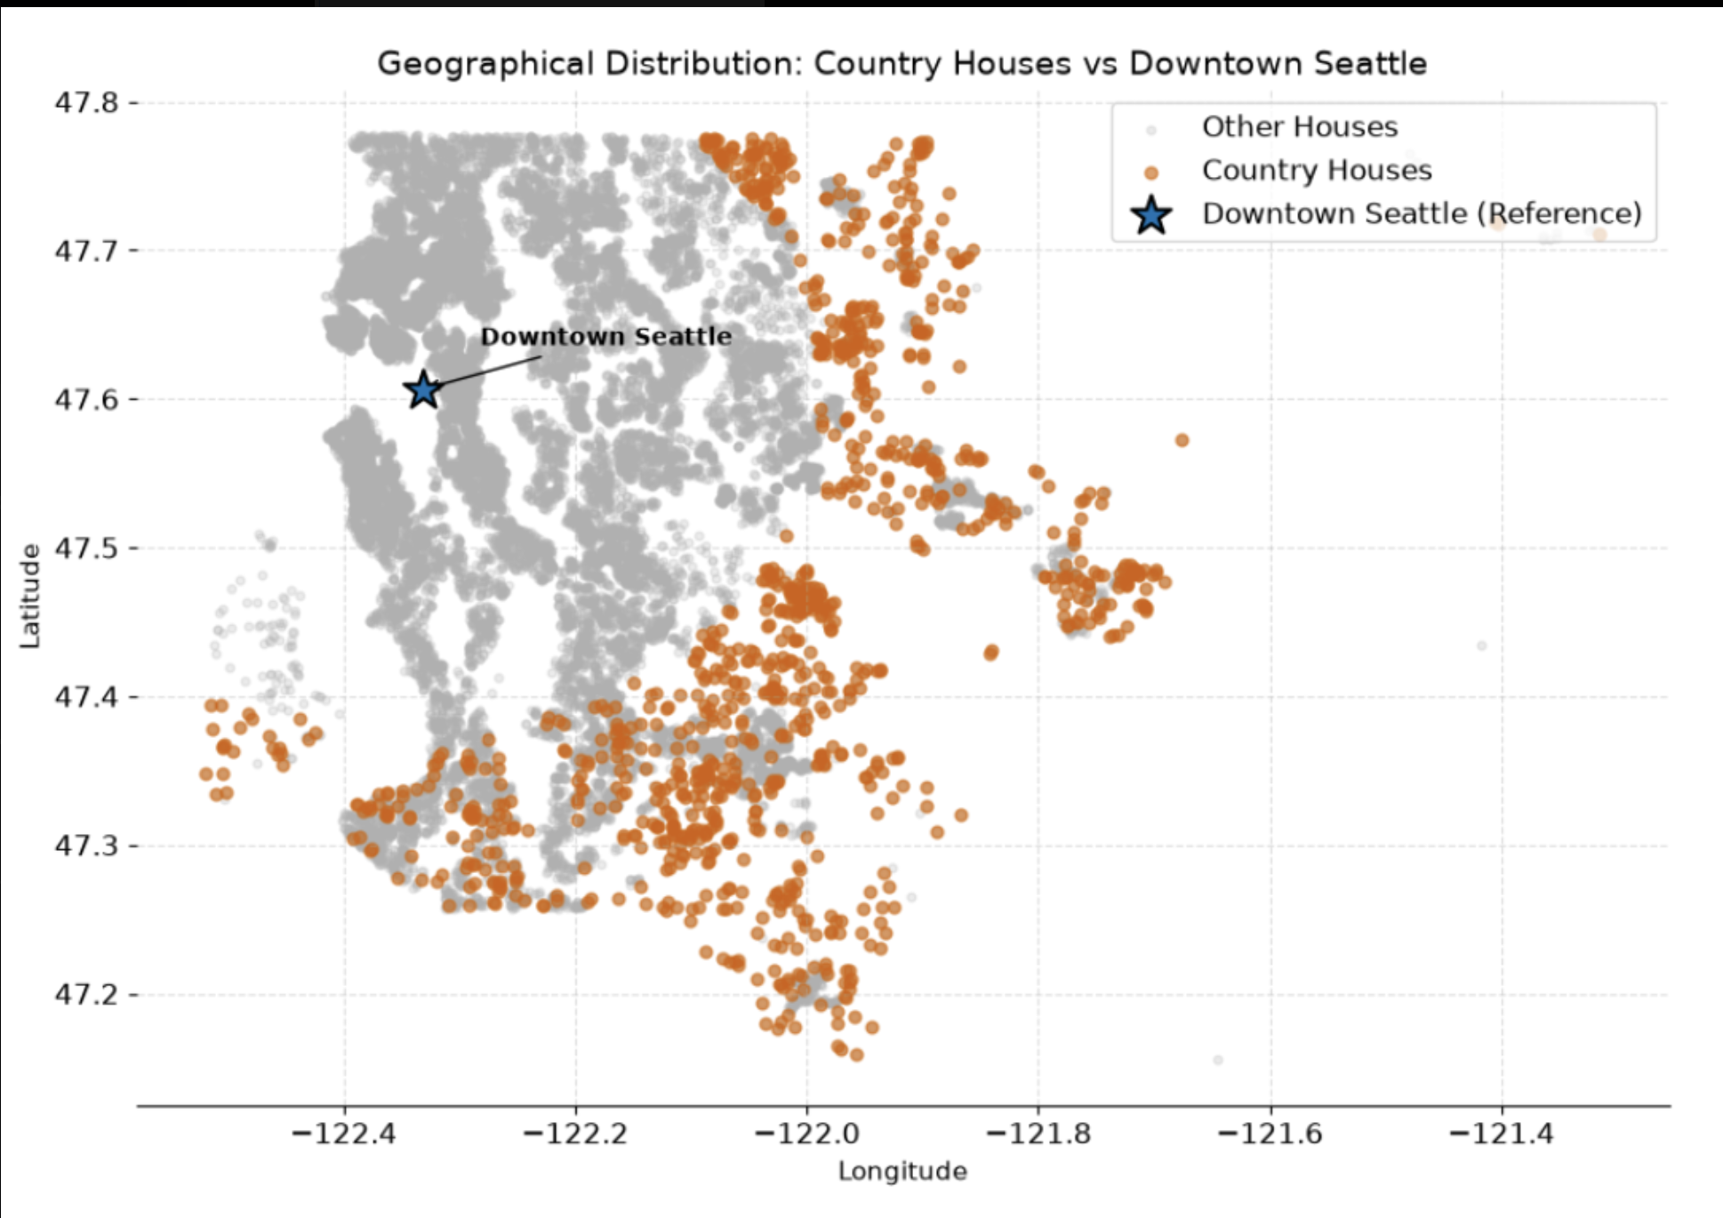
1,081 country houses ring the Seattle area
H1 · COUNTRY HOUSE · WHERE THEY ARE
10 / 18
Two homes for William · EDA
Notes:
⏱ 0:40 — Speaker: [name]. ▶ Read the title aloud, then let the map speak. Point out where the country houses are compared with downtown Seattle, and remind the audience of the two thresholds that define them: distance from downtown and lot size. These are the homes we tested in H1.

Slide 11
Off-season buying does not save money
H1 · COUNTRY HOUSE · TIMING — THE VERDICT
REJECTED
+5.9%
median $/sqft in Oct–Feb ($274) vs Mar–Sep ($259) · not significant, p = 0.26
→ FOR WILLIAM
No need to wait for winter: buy when the right country house comes up
No seasonal saving: 26 Oct–Feb vs 49 Mar–Sep sales
Two homes for William · EDA
11 / 18
Notes:
⏱ 1:00 — Speaker: [name]. ▶ Read the title aloud — it is the answer. Point to the highlighted part of the chart, state the verdict (confirmed / rejected) and the key number, then land the recommendation: what William should do and what it saves him.

Slide 12
Hypothesis 2
H2
PART 03
City house · Central location
Notes:
⏱ 0:05 — Transition: “Now the city house: where can William find the right home, fast?”

Slide 13
Where are compact city homes easiest to find?
H2 · CITY HOUSE · LOCATION — THE TEST
WHAT IT TOOK TO TEST IT
01
Variables we used
lat, long, bedrooms, sqft_living, price
OUR HYPOTHESIS
1–2 bedroom compact houses are significantly more concentrated within 10 miles of the city centre than in outer areas, and command a higher price per sqft.
02
Who we compared
1–2 bed, 400–1,500 sqft · within vs beyond 10 mi
03
How we compared
Share of homes and median $/sqft · Mann-Whitney U
Two homes for William · EDA
13 / 18
Notes:
⏱ 0:40 — Speaker: [name]. ▶ Read the question aloud, then the hypothesis. Explain how we computed distance to the city centre from latitude and longitude (and which point we used as “centre”), which homes we compared, and the two measures: how many homes and how expensive per sqft.

Slide 14
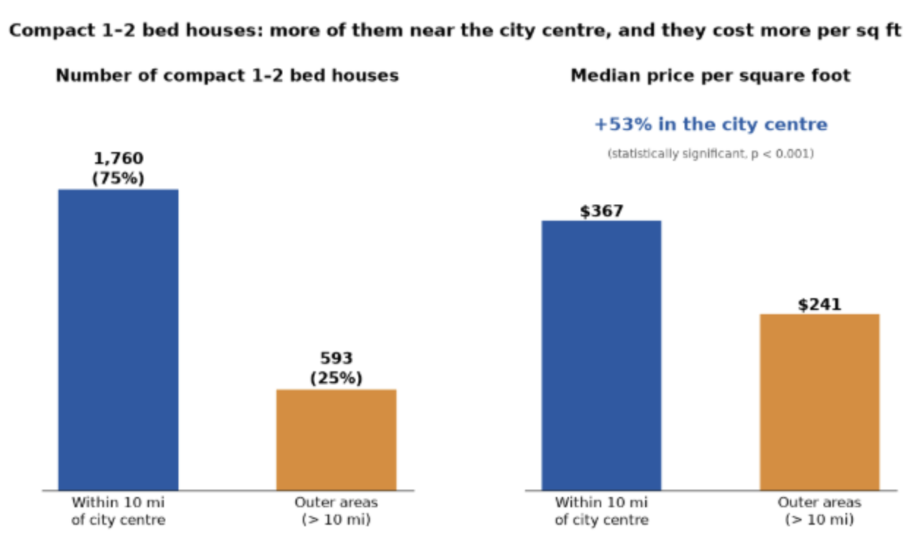
75% of compact homes sit within 10 miles
H2 · CITY HOUSE · LOCATION — THE VERDICT
CONFIRMED
75%
of 1–2 bed homes within 10 mi (1,760 of 2,353) · +53% $/sqft vs outer areas ($367 vs $241)
→ FOR WILLIAM
Search within 10 miles of the centre to buy fast
Budget for a ~53% premium per sqft: ~$128,000 more on a 1,010 sqft home
Two homes for William · EDA
14 / 18
Notes:
⏱ 1:00 — Speaker: [name]. ▶ Read the title aloud — it is the answer. Two parts to the verdict: concentration (lots of supply near the centre, so William can buy fast) and price (the premium he pays for being central). Then land the recommendation.

Slide 15
Hypothesis 3
H3
PART 04
Country house · Non-renovated
Notes:
⏱ 0:05 — Transition: “Back to the country house: does buying unrenovated really save money?”

Slide 16
Does skipping the renovation save money?
H3 · COUNTRY HOUSE · CONDITION — THE TEST
WHAT IT TOOK TO TEST IT
01
Variables we used
yr_renovated, sqft_living, sqft_lot, lat, long, price
OUR HYPOTHESIS
02
Who we compared
Unrenovated country houses sell at a 15–20% lower price per sqft than renovated homes in the same country areas.
Country houses · 75 never renovated vs 6 renovated
03
How we compared
Mean $/sqft gap vs the 15–20% target · α = 0.05
Two homes for William · EDA
16 / 18
Notes:
⏱ 0:40 — Speaker: [name]. ▶ Read the question aloud, then the hypothesis. Explain how “renovated” was defined (yr_renovated > 0), that we compared the same country-house group as H1 (16+ miles, lot of 20,000+ sqft, 1–2 bed, 400–2,000 sqft), and what gap we expected (15–20%).

Slide 17
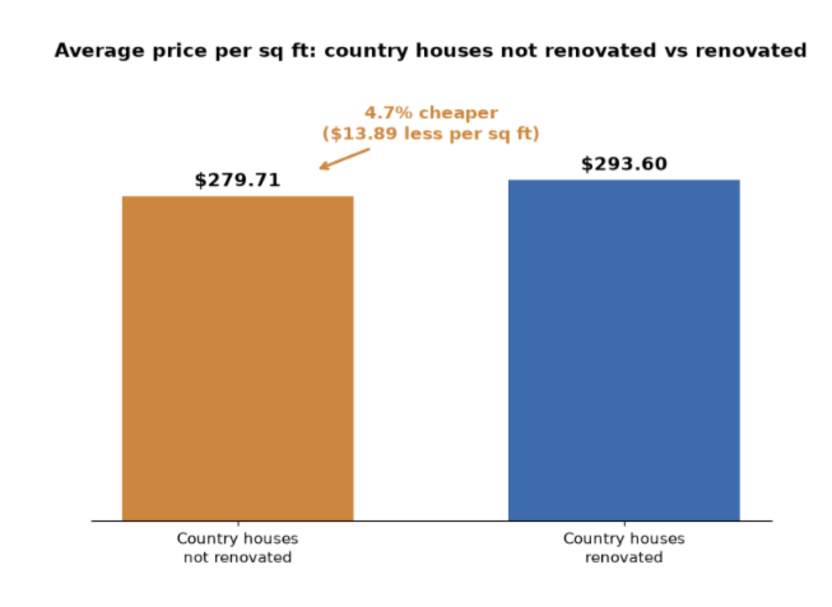
Non renovated saves only 4.7% per sqft
H3 · COUNTRY HOUSE · CONDITION — THE VERDICT
REJECTED
−4.7%
mean $/sqft: $279.71 unrenovated vs $293.60 renovated · target 15–20% · only 6 renovated homes
→ FOR WILLIAM
Don’t count on a big discount for skipping the renovation
Saving: ~$16,700 on a 1,200 sqft home
Two homes for William · EDA
17 / 18
Notes:
⏱ 1:00 — Speaker: [name]. ▶ Read the title aloud — it is the answer. The gap (4.7%) landed well below the 15–20% range and is not significant (p = 0.99, only 6 renovated homes to compare). Combine with H1 for the full country-house advice: neither the season nor skipping the renovation brings a meaningful discount, so William should focus on finding the right house.

Slide 18
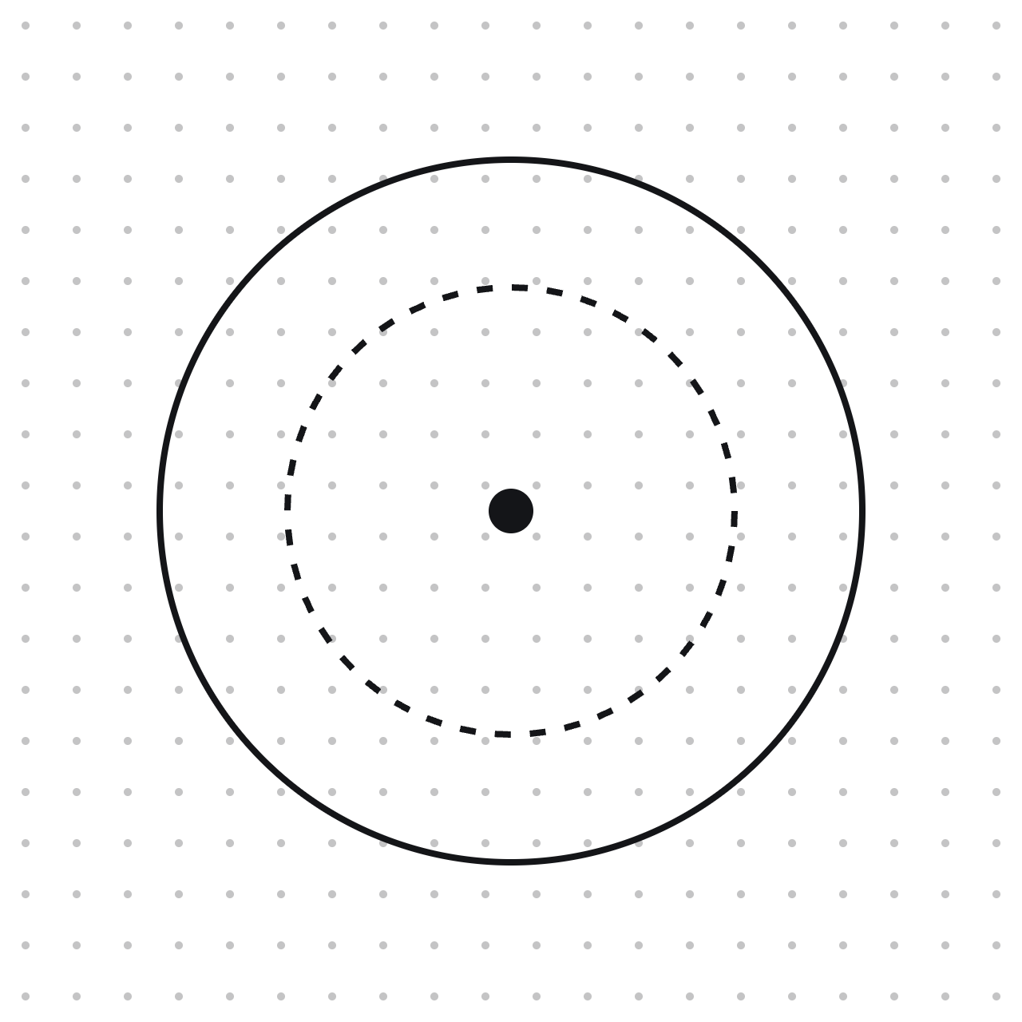
Thank you.
Q&A
Questions?
Trupti, Serena
Notes:
Q&A — have backup answers ready: dataset limits (time range, region), how “country” vs “city” was defined, and which statistical test was used.

